Slide 1


CVA-FCA: Conceptual Disambiguation of Word Embeddings
Hayri Volkan Agun
Computer Engineering Department
ISCMI 2026 - Vienna, Austria

Slide 2
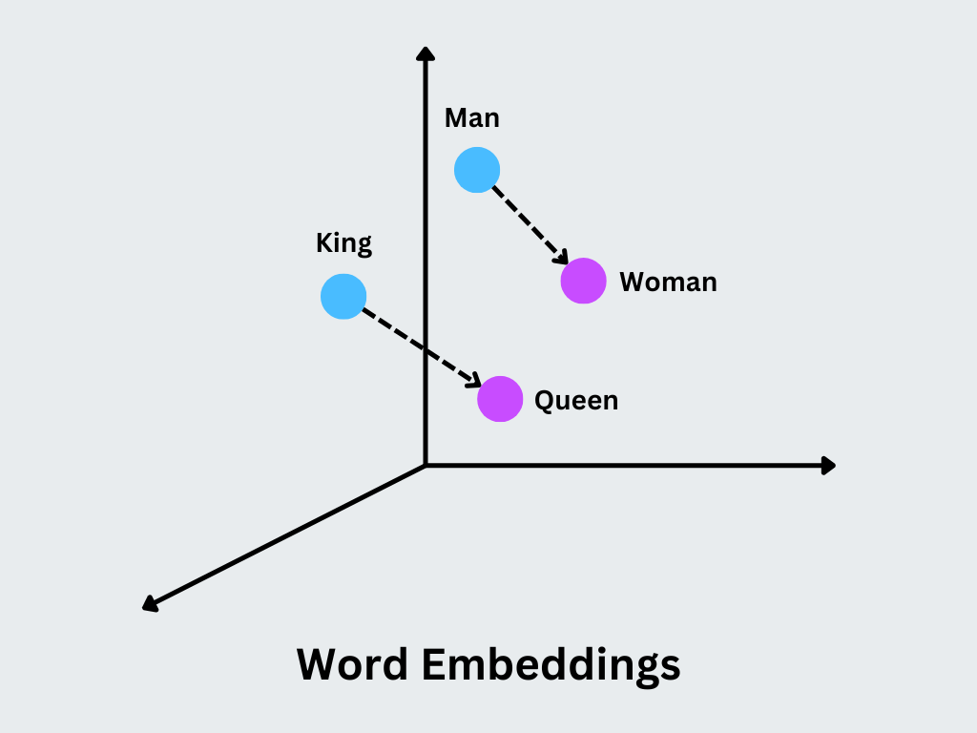
Word Embeddings
Word embeddings is the new defacto standard for feature extraction in natural language processing tasks.
They encode syntactic and semantic information as dense vectors, preserving geometric relationships between words based on their syntactic and semantic similarities.
Words with similar meanings or used in similar contexts are mapped close to each other.

Slide 3
Problems of Word Embeddings
A word with multiple meanings are represented by single embedding.
A word has an embedding that is isolated from its context.
SOLUTION:
Instead of looking up a fixed vector from a static dictionary, the embedding is computed on the fly by processing the entire input sequence.
CONS:
Relational information do not have sentence/sequence context.
Sentence level embeddings are not good at relational logic.

Slide 4
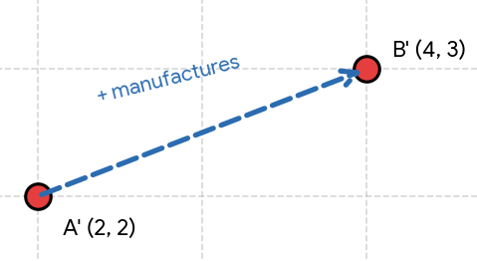
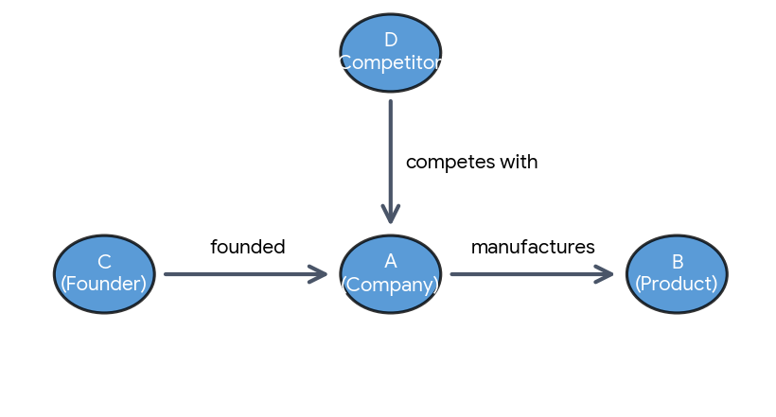
Relational Embeddings
Knowledge graphs use relational embeddings.

Slide 5
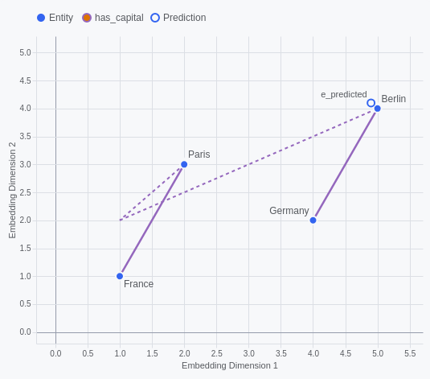
Relational Embeddings
Analogy tasks use relational embeddings.
France - Paris = Germany - ?
The question mark is searched from embedding disctionary.
3CosAdd uses cosinus similarity to retrieve the most similar word.

Slide 6
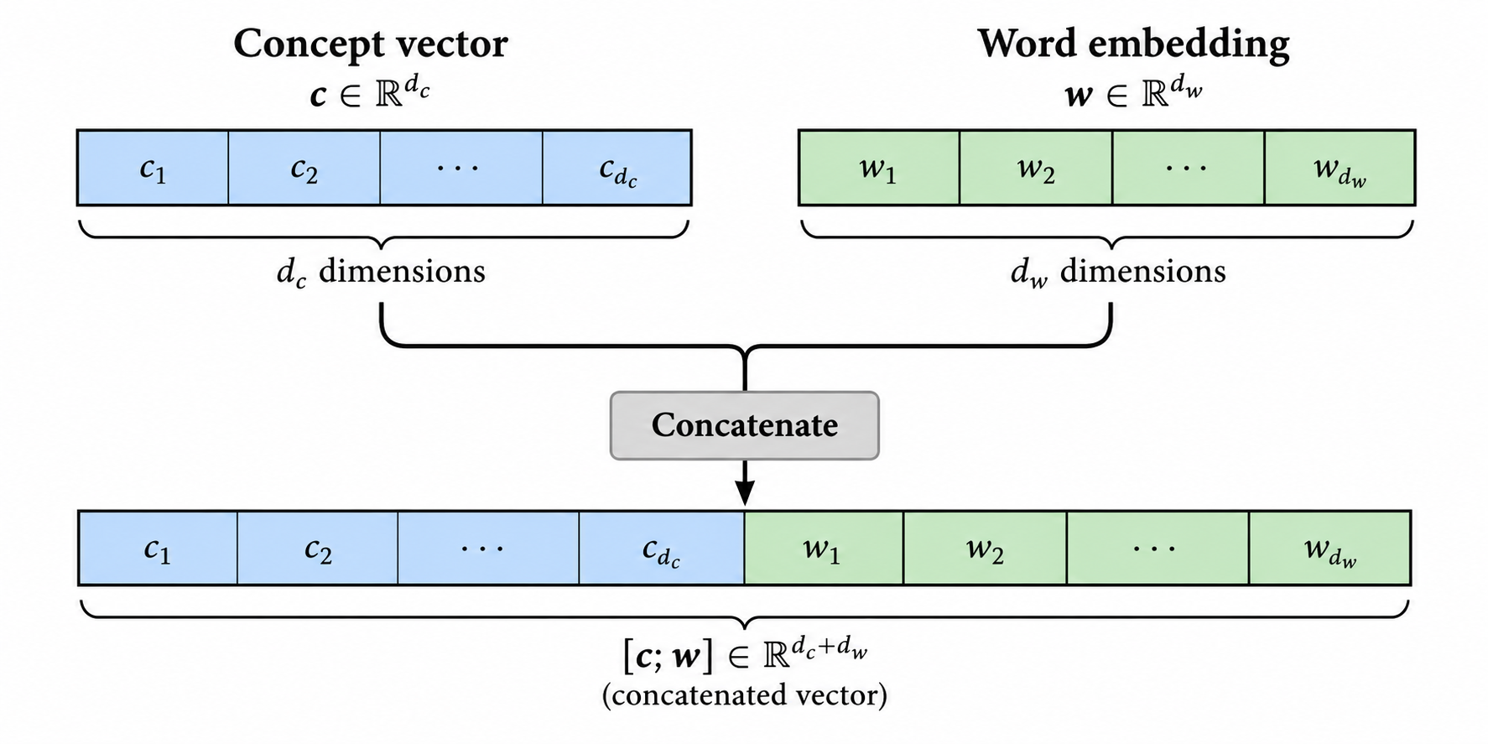
Concept Embedding
What if a word has multiple embeddings depending on the concept it belongs to.

Slide 7
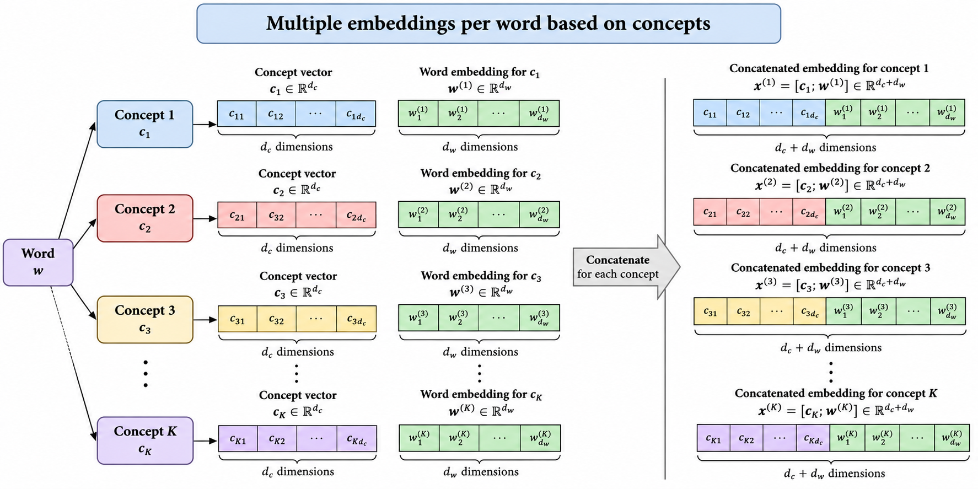
Concept Embedding

Slide 8
Unsupervised concept learning
If we cluster each word embedding and extract the shared representation of these words we can obtain the concept vectors.
Formal concept analysis is the most appropriate method for concept extraction.

Slide 9
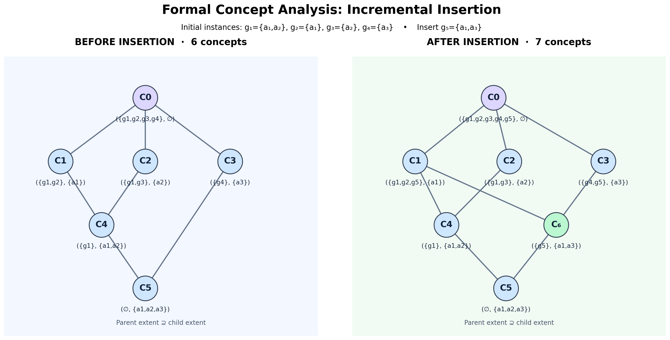
Formal Concept Analysis (FCA)

Slide 10
Formal Concept Analysis (FCA)
PROBLEM?
We only have word vectors.There is not any attribute for each word.
SOLUTION:
Use embedding vectors as attributes that represent the word.

Slide 11
Formal Concept Analysis (FCA)
PROBLEM?
FCA node membership and set intersection is used to represent concept nodes. In attribute vector we cannot determine the concept nodes through set intersection or attribute membership
SOLUTION
A) Use common vector approach (CVA) to test whether an instance belongs to the concept.
B)Derive the common invariant properties of intersected concepts. Use instance unification to find the common intersected parent concept.

Slide 12
Common Vector Approach (CVA)
The Common Vector Approach (CVA) is a subspace-based representation method that extracts the common characteristics of samples belonging to the same class.
The central idea is to decompose each input vector into two components:
  1. Common component: The information shared by the samples belonging to a class.
  2. Difference component: The information responsible for variations among the samples.
For a collection of vectors belonging to the same class, CVA identifies the subspace containing within-class variations and removes these variations to obtain a common vector.

Slide 13
Common Vector Approach
Each concept is represented by a common vector and a transformation matrix.
Concept membership is done through measuring the distance to the common vector.
Concept intersections use the instances to extract common vectors.

Slide 14
CVA-FCA
Full lattice search for intersection with the incomming instance is costly.
Bound the search by using beam search strategy starting from the bottom up to find the appropriate sub-nodes.

Slide 15
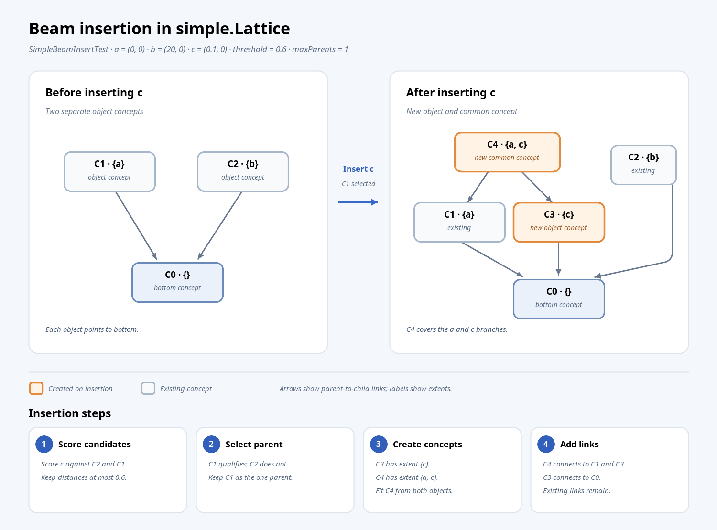
CVA-FCA : FastAddIntent through Beam Search
The beam searches for similar nodes to the instance by using common vector approach.
If candidate nodes returned by the beam search do not contain the instance, they are used for creating new parents.
In figure C1 is a candidate node, the parent contains the common vector for the new concept and C1.
Common vector is computed from the union of the new instance and C1 extends.

